Slide 1


Do You Really Know What Architecture Is？
Haikuan Li, Visiting Professor NPU
CLEBA Group, Delfgauw
The Netherlands
Haikuan Li “Software Development of Dataization Intelligence Architecturization and Intensification (Lecture Notes)” Seminar on Intelligent Software Development at Northwestern Polytechnical University(NPU), Xi’an, China, 2020
Notes:
The title of the course is “Software Development Paradigm in the Era of Big Data”.

Slide 2
Exploring the Software Architecture 软件架构探秘
Although the architecture-centric software development model is being accepted by more and more software projects, the software architecture so far is still a buzzword. There are dozens of different definitions and various styles. Do you really know what software architecture is?
虽然以架构为中心的软件开发模式正被越来越多的软件项目所接受，但迄今为止的软件架构依然是一个“Buzzword”，不同的定义就有几十个。你真得知道什么是软件架构吗？

Slide 3

Software Data Mining and Unsupervised Machine Learning
for System Re-Architecting
Three-Step Approach
Architecture
Transformation
Old
Architecture
New
Architecture
In genetic engineering, we get gene structure from tissues and implant it back to the tissues.
Architecture
Recovery
Architecture
Implantation
Legacy System
Recovery – Get an architecture from existing system
Transformation – Restructure the old architecture into a new one.
Build In – Build the new architecture back into the existing system
Maintenance – Software Maintenance with the new architecture

Slide 4

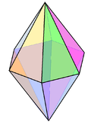
The Three-Step Approach to System Complexity in General
There are many large and complex legacy systems for reuse in development and maintenance.
The systems dealing with big data may have additional complexity.
The system's system in internet may be very large and complex.
Emerging internet complexity is increased enormously.
Internet: Connecting all the PCs
Mobile Internet: Connecting all the people
Internet of things：Connecting everything
Internet, the large & complex system which is continuously used, developed and maintained globally.

Slide 5

The basic concepts to be discussed
What is Software Architecture?
What is Software System?
What is Software Re-Architecting?
Notes:
the basic concepts

Slide 6

About System Architecture
For the collection of definition, which one do you agree upon?
Should a software architecture a fuzzy or concrete artifact?
If architecture is an abstraction of a system, what is the proper degree of the abstraction?
If software architecture have different styles, for example, function-oriented architecture, object-oriented architecture and service-oriented architecture, what are the features of the styles?
What are the relationships between the styles?
Which type of the architectures is useful to deal with system complexity?

Slide 7
Properties of Software Architecture
Does a single system has one and only one Architecture?
Is it always too late to modify system architecture after implementation?
Can't you change system architecture without modifying the system code?

Slide 8
What is Software Architecture? The issue of SEI /CMU
Architecture serves as the blueprint for both the system and the project developing it, defining the work assignments that must be carried out by design and implementation teams.
The architecture is the primary carrier of system qualities, such as performance, modifiability, and security, none of which can be achieved without a unifying architectural vision.
Architecture is an artifact for early analysis to make sure that the design approach will yield an acceptable system.
Architecture holds the key to postdeployment system understanding, maintenance, and mining efforts.
In short, architecture is the conceptual glue that holds every phase of the project together for all its many stakeholders.

Slide 9
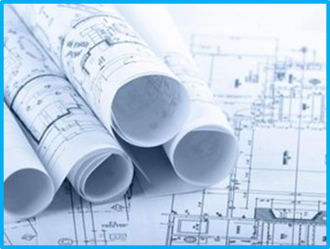
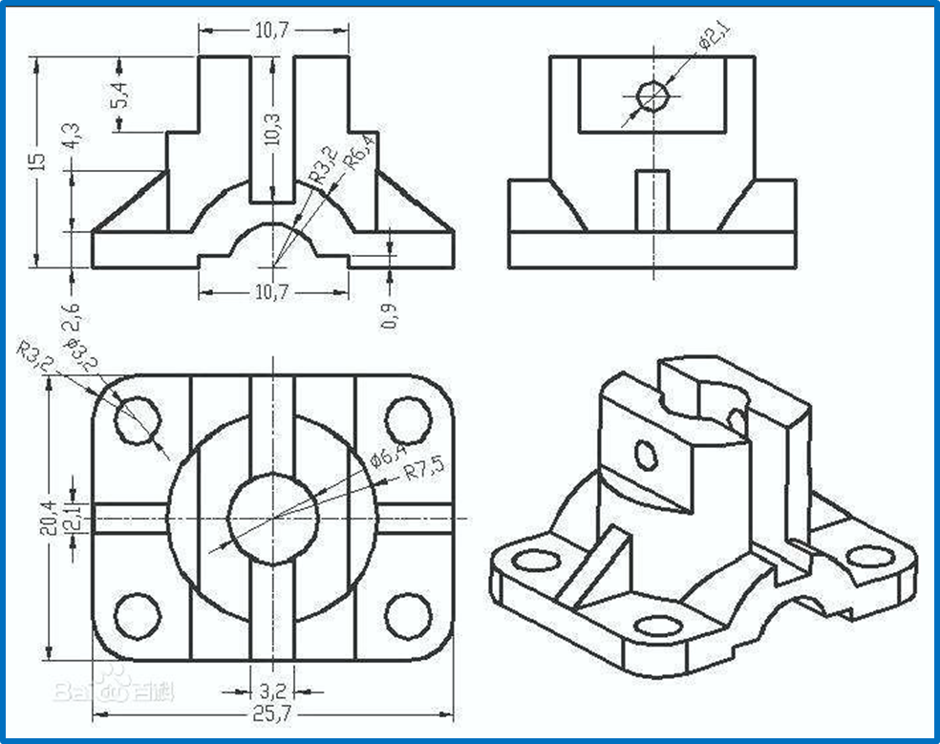
How to Represent Architecture?
A blueprint is a reproduction of a technical drawing, documenting an architecture or an engineering design, using a contact print process on light-sensitive sheets. [wiki]

Slide 10
Software Architecture (System Views)
End-User
Functionality
Developers
Software Management
Logical view: The logical view is concerned with the functionality that the system provides to end-users.
Development view: The development view illustrates a system from a programmer's perspective and is concerned with software management.
Physical view: The physical view depicts the system from a system engineer‘s point of view. It is concerned with the topology of software components on the physical layer as well as the physical connections between these components. This view is also known as the deployment view.
Process view: The process view deals with the dynamic aspects of the system, explains the system processes and how they communicate, and focuses on the runtime behavior of the system. The process view addresses concurrency, distribution, integrators, performance, and scalability, etc.
Scenarios consists of a small set of use cases that describe sequences of interactions between objects and between processes. They are used to identify architectural elements and to illustrate and validate the architecture design. They also serve as a starting point for tests of an architecture prototype. This view is also known as the use case view.
Logical
View
Development
View
Scenarios
Process
View
Physical
View
Integrators
Performance
Scalability
System Engineers
Topological structure
Communication
Kruchten, Philippe, “Architectural Blueprints — The “4+1” View Model of Software Architecture” IEEE Software 12 (6), pp. 42-50, Nov. 1995

Slide 11
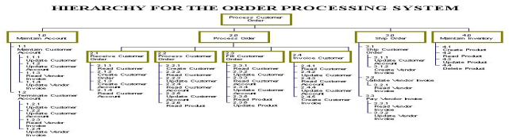
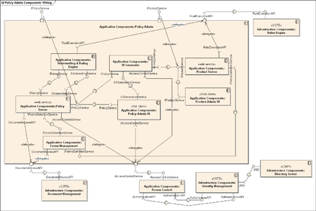
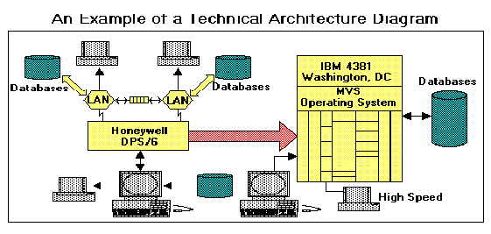
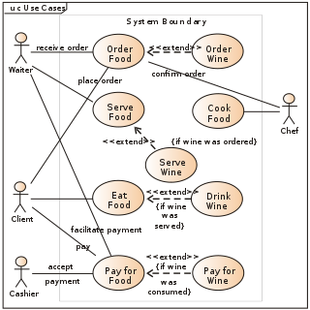
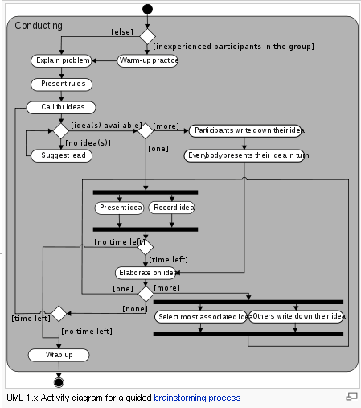
Architecture Views ⎯looking at the same system at abstract level from different corners
Class diagram –Logical view
Component diagram –Development view
Logical view : The logical view is concerned with the functionality that the system provides to end-users. UML Diagrams used to represent the logical view include Class diagram, Communication diagram, Sequence diagram.
Physical view describes the structure and behavior of the technology infrastructure of an enterprise, solution or system
Scenarios : The description of an architecture is illustrated using a small set of use cases.
Development view : The development view illustrates a system from a programmer's perspective and is concerned with software management.
Process view deals with the dynamic aspects of the system, explains the system processes and how they communicate, and focuses on the runtime behavior of the system [Bass 2003]
Infrastructure –Physical view
Use case – Scenarios view
Activity diagram –Process view

Slide 12
Architecture Space
I think there should be an architecture space in according to evolution, abstraction and the point of view.
Abstraction
View
Evolution
As a system architecture is an abstraction of the system, there could be a set of architectures with different levels of abstraction.
As a system architecture is a view about the system, there must be a set of architectures of the system according to the views from different corners.
As a system architecture may be different if the system is changed, there must be a set of architectures in the process of system evolution.

Slide 13

Development View
Development view: The development view illustrates a system from a programmer's perspective and is concerned with software management. This view is also known as the implementation view. It uses the UML Component diagram to describe system components. UML Diagrams used to represent the development view include the Package diagram.[2]

Slide 14
Architectural Styles
FOA (Function-Oriented Architecture)
Stepwise refinement
Different levels of abstraction
OOA (Object-Oriented Architecture)
Object-oriented
Loosely coupled
Class hierarchy for inheritance
SOA (Service-Oriented Architecture)
Service-oriented
Loosely coupled
Different Levels of Abstraction
ROA (Relation-Oriented Architecture)
Function/Object/Service-oriented / Component Based
Loosely coupled
Different Levels of Abstraction

Slide 15

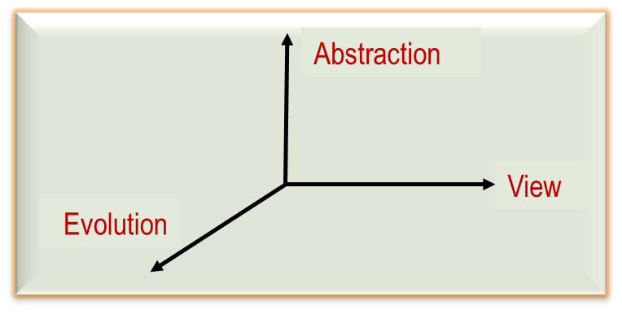
Q&A

Slide 16
Q&A：Software Architecture
What is software architecture?
Why software architecture is a blueprint of a software system?
What is the relationship between software architecture and software design?
What is system view?
Why development view is essential to system complexity?
What is function-oriented architecture (FOA)?
What is object-oriented architecture (OOA)?
What is service-oriented architecture (AOA)?
What is relation-oriented architecture (ROA)？

